Slide 2
Médicament de substitution aux opioïdes (MSO) (TAO) en France, retour d’expérience en temps d’épidémie
Par Jean-Michel Delile

Slide 3
MSO en France, contexte
En France en 2017, 162 500 personnes ont bénéficié d’un remboursement de MSO délivrés en ville ; soit 2,2/1 000 assurés sociaux.
Buprénorphine haut dosage (BHD, hors Suboxone) : 61 % (99 500 personnes)
Méthadone : 38 % (61 500 personnes) dont plus de la moitié (57 %) sous forme de gélules
Suboxone (buprenorphine/naloxone) : 5 % (7 500 personnes)
CSAPA : 52 000 patients bénéficient d’un MSO (36 000 méthadone, 16 000 BHD)
Différences de réglementation : prescription et dispensation initiales de méthadone limitées aux CSAPA (possibilité de relais en ville), prescription et délivrance de BHD possibles d’emblée en ville (MG et pharmacies)

Slide 4
COVID et approvisionnement en MSO
Durant le confinement lors de l’Etat d’urgence sanitaire, les règles de prescription et de délivrance des MSO ont été rapidement assouplies pour prévenir des difficultés d’approvisionnement des MSO. Echanges rapides et fructueux DGS/FA
Téléconsultations, ordonnances par fax ou courriel
Plusieurs arrêtés (19 mars, 23 mars et 1er avril 2020) ont autorisé les pharmaciens à renouveler d’eux-mêmes les délivrances de MSO et de stupéfiants (jusqu’au 31 mai 2020) à l’issue de la durée de validité de la dernière ordonnance (si traitement d’au moins 3 mois).
Modalités de fractionnement inchangées et chevauchement impossible, pour limiter la constitution de stocks.
Les commandes de MSO par les pharmacies d’officine ont été analysées durant cette période (17/03 au 11/05/2020) afin d’étudier l’influence du confinement :
Pas de diminution : les ventes de MSO ont même été en légère augmentation : + 1,8 %
Augmentation due à la méthadone : + 10 %

Slide 5
Pic méthadone en mars 2020
Réplique en août (+ 15 % gélules)
(Données Bouchara-Recordati)
Prescriptions de précaution
Réduction du trafic de rue (héroïne, morphine, MSO, opioïdes…)
Difficultés d’accès au médecin traitant (MSO, opioïdes antalgiques)
Crainte d’être en rupture (anticipation)
Amélioration paradoxale et inattendue de l’accès aux soins en CSAPA
Augmentation délivrance pharmacie/centre

Slide 6
Surdoses France 1er semestre 2020/2019 (données partielles, BNPV/ANSM) (74/59 dont mortelles 21/20)

Slide 7
Syndemics et COVID Trends in US Emergency Department Visits for Mental Health, Overdose and Violence Outcomes Before and During the COVID-19 Pandemic (Holland et al. 2021, JAMA Psychiatry) All Drug and Opioid Overdoses (ODs), Intimate Partner Violence (IPV), Suicide Attempts (SAs), Mental Health Conditions (MHCs), and Suspected Child Abuse and Neglect (SCAN) in the US (December 30, 2018, to October 10, 2020)
Nombre de passages
Part relative par causes

Slide 8
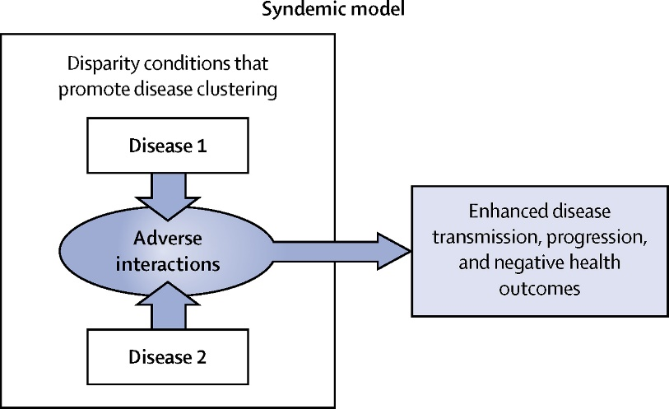
« Syndemics » : la santé en contexte (Lancet, 2017, 389, 881)
Le modèle syndémique (“syndemics model”) de santé repose sur un complexe biosocial qui intègre :
des maladies en interaction, coprésentes ou séquentielles, et
les facteurs sociaux ou environnementaux qui
favorisent cette synergie épidémique et
augmentent les effets négatifs de cette interaction.
90’s, Merrill Singer (anthropologue médical) :
SAVA (substance abuse, violence, and AIDS)

Slide 9
Comment
As Singer and colleagues wrote in 2017, “A syndemic approach provides a very different orientation to clinical medicine and public health by showing how an integrated approach to understanding and treating diseases can be far more successful than simply controlling epidemic disease or treating individual patients.”
I would add one further advantage. Our societies need hope. The economic crisis that is advancing towards us will not be solved by a drug or a vaccine. Nothing less than national revival is needed. Approaching COVID-19 as a syndemic will invite a larger vision, one encompassing education, employment, housing, food, and environment. Viewing COVID-19 only as a pandemic excludes such a broader but necessary prospectus.
Offline: COVID-19 is not a pandemic
As the world approaches 1 million deaths from COVID-19, we must confront the fact that we are taking a far too narrow approach to managing this outbreak of a new coronavirus. We have viewed the cause of this crisis as an infectious disease. All of our interventions have focused on cutting lines of viral transmission, thereby controlling the spread of the pathogen. The “science” that has guided governments has been driven mostly by epidemic modellers and infectious disease specialists, who understandably frame the present health emergency in centuries-old terms of plague. But what we have learned so far tells us that the story of COVID-19 is not so simple. Two categories of disease are interacting within specific populations—infection with severe acute respiratory syndrome coronavirus 2 (SARS-CoV-2) and an array of non-communicable diseases (NCDs). These conditions are clustering within social groups according to patterns of inequality deeply embedded in our societies. The aggregation of these diseases on a background of social and economic disparity exacerbates the adverse effects of each separate disease. COVID-19 is not a pandemic. It is a syndemic. The syndemic nature of the threat we face means that a more nuanced approach is needed if we are to protect the health of our communities.
Addressing COVID-19 means addressing hypertension, obesity, diabetes, cardiovascular and chronic respiratory diseases, and cancer. Paying greater attention to NCDs is not an agenda only for richer nations. NCDs are a neglected cause of ill-health in poorer countries too. In their Lancet Commission, published last week, Gene Bukhman and Ana Mocumbi described an entity they called NCDI Poverty, adding injuries to a range of NCDs— conditions such as snake bites, epilepsy, renal disease, and sickle cell disease. For the poorest billion people in the world today, NCDIs make up over a third of their burden of disease. The Commission described how the availability of affordable, cost-effective interventions over the next decade could avert almost 5 million deaths among the world’s poorest people. And that is without considering the reduced risks of dying from COVID-19.
Peter Scholey Partnership/Getty Images
*
The most important consequence of seeing COVID-19 as a syndemic is to underline its social origins. The vulnerability of older citizens; Black, Asian, and minority ethnic communities; and key workers who are commonly poorly paid with fewer welfare protections points to a truth so far barely acknowledged—namely, that no matter how effective a treatment or protective a vaccine, the pursuit of a purely biomedical solution to COVID-19 will fail. Unless governments devise policies and programmes to reverse profound disparities, our societies will never be truly COVID-19 secure. As Singer and colleagues wrote in 2017, “A syndemic approach provides a very different orientation to clinical medicine and public health by showing how an integrated approach to understanding and treating diseases can be far more successful than simply controlling epidemic disease or treating individual patients.” I would add one further advantage. Our societies need hope. The economic crisis that is advancing towards us will not be solved by a drug or a vaccine. Nothing less than national revival is needed. Approaching COVID-19 as a syndemic will invite a larger vision, one encompassing education, employment, housing, food, and environment. Viewing COVID-19 only as a pandemic excludes such a broader but necessary prospectus.
Allison Michael Orenstein/Getty Images
*
The notion of a syndemic was first conceived by Merrill Singer, an American medical anthropologist, in the 1990s. Writing in The Lancet in 2017, together with Emily Mendenhall and colleagues, Singer argued that a syndemic approach reveals biological and social interactions that are important for prognosis, treat- ment, and health policy. Limiting the harm caused by SARS-CoV-2 will demand far greater attention to NCDs and socioeconomic inequality than has hitherto been admitted. A syndemic is not merely a comorbidity. Syndemics are characterised by biological and social interactions between conditions and states, interactions that increase a person’s susceptibility to harm or worsen their health outcomes. In the case of COVID-19, attacking NCDs will be a prerequisite for successful containment. As our recently published NCD Countdown 2030 showed, although premature mortality from NCDs is falling, the pace of change is too slow. The total number of people living with chronic diseases is growing.
xavierarnau/Getty Images
Richard Horton
richard.horton@lancet.com
874
www.thelancet.com Vol 396 September 26, 2020

Slide 10
Conclusions et Retex
Approvisionnement maintenu en MSO grâce à une mobilisation générale (patients, professionnels, industriels, institutionnels…) et à une utilisation élargie des téléconsultations et de la télétransmission (ordonnances)
Accessibilité paradoxalement facilitée
Augmentation méthadone (CSAPA) : + 44 % (mars 2020/2019) !
Arrivée de nouveaux patients au début du confinement :
Amélioration de l’accès aux soins pour des personnes éloignées du soin (social, géographie…) : leçons à retenir pour l’après-COVID
Initiations méthadone et sulfate de morphine
Augmentation de diffusion de la naloxone mais OD
Relais vers les pharmacies d’officine plus fréquents et durables, idée à poursuivre (accessibilité en milieu rural…)
TAO alternatifs ? Groupe de travail ANSM (morphine LP, orale et injectable)
Prise en charge globale

